Slide 1



Analysis of multispectral and multitemporal Landsat data
GEO4515
Anna Eliassen og Kristina Othelia Olsen

Slide 2
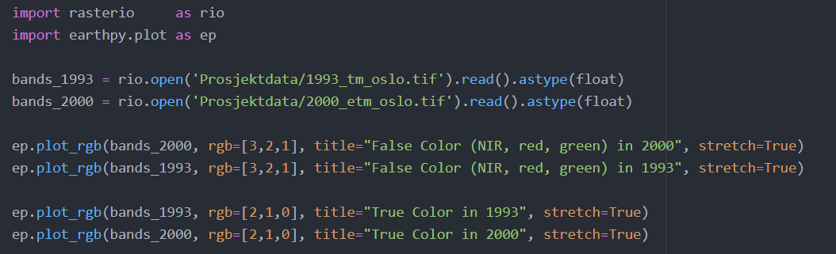
Python kode

Slide 3
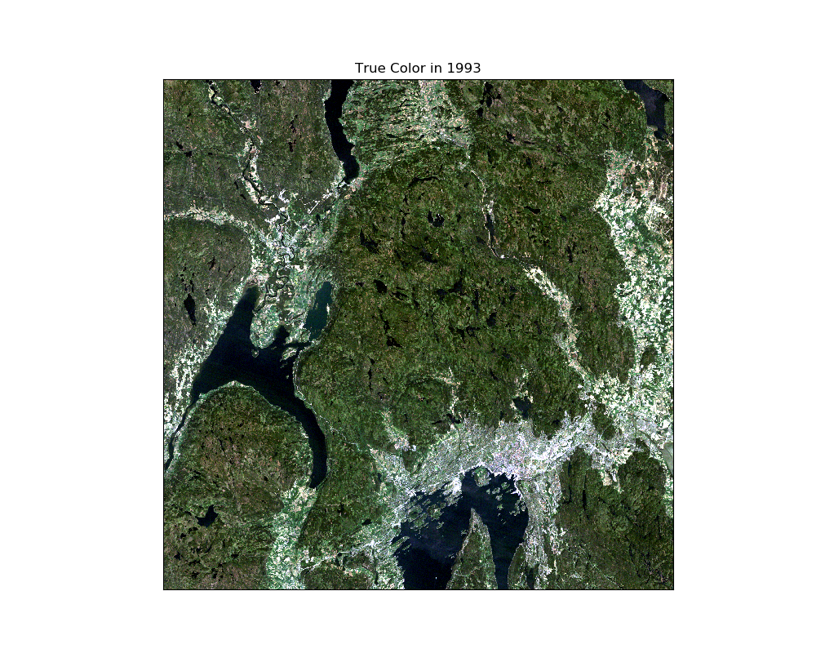
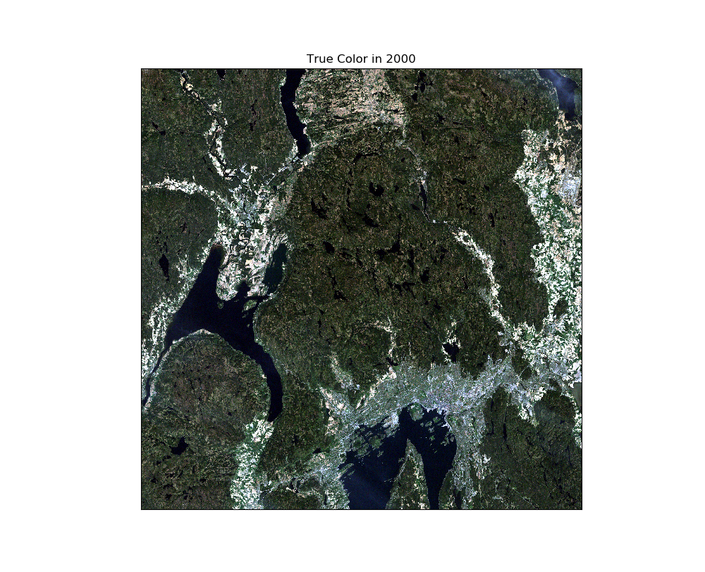
Spectral signatures
True color – June 1993
True color – May 2000

Slide 4
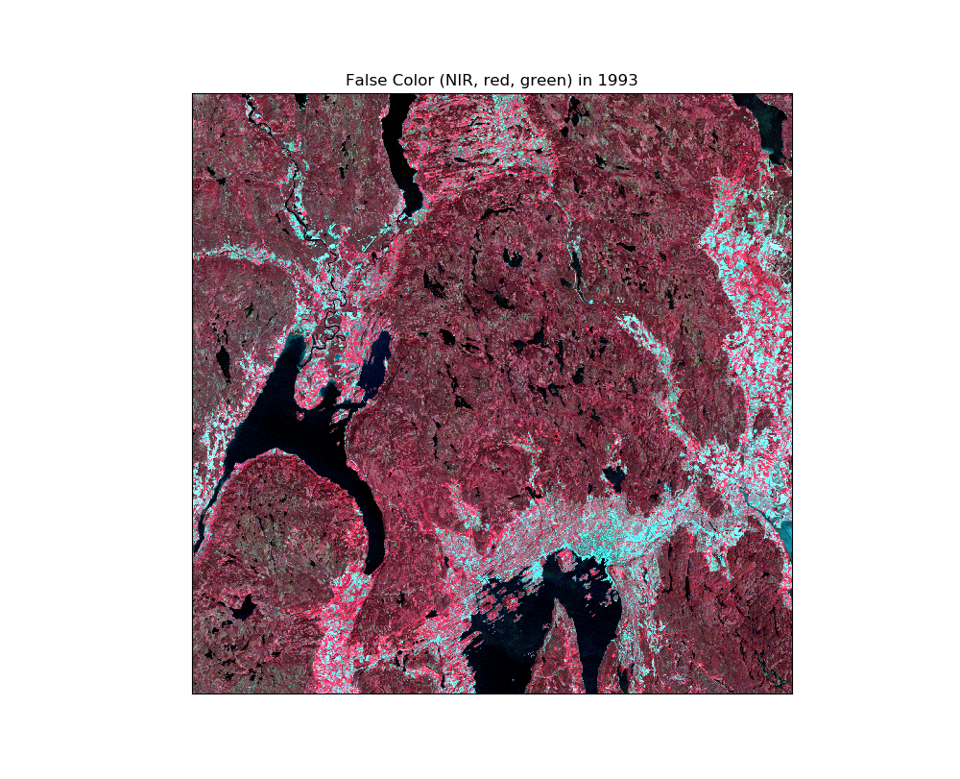
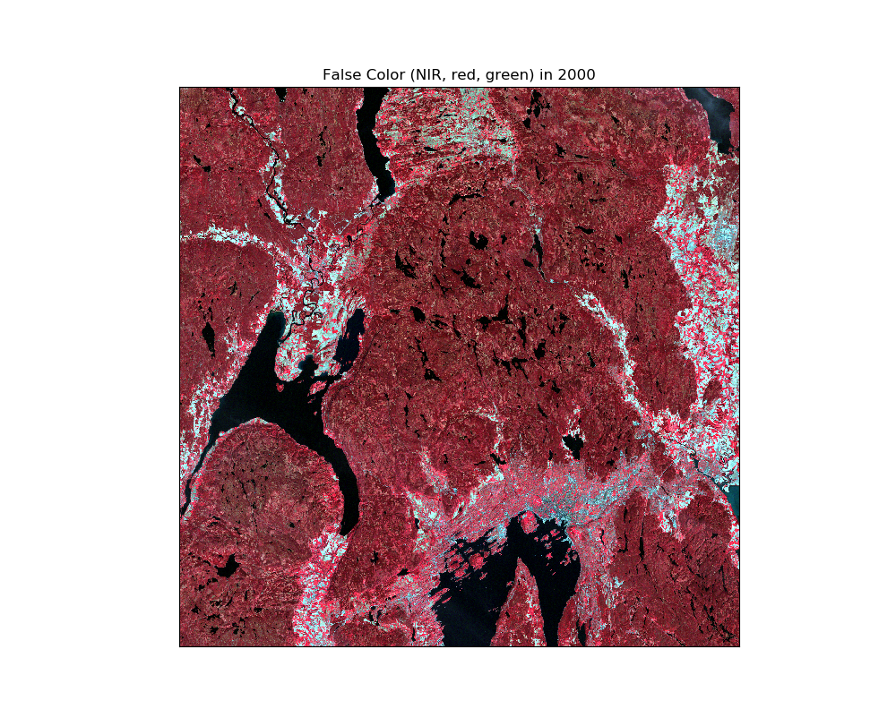
Spectral signatures
False color – June 1993
False color – May 2000

Slide 5
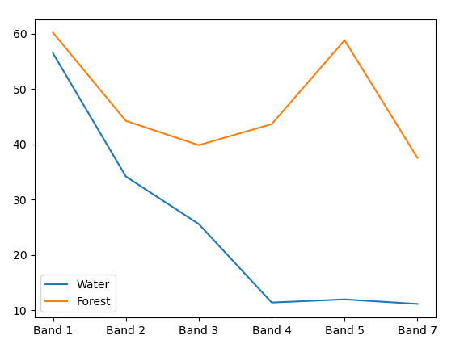
Spectral signatures
Vann
Skog/landbruk

Slide 6
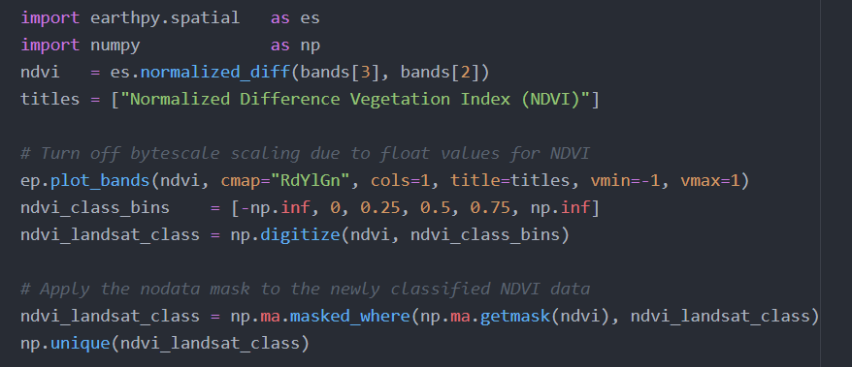
Normalized difference vegetation index

Slide 7
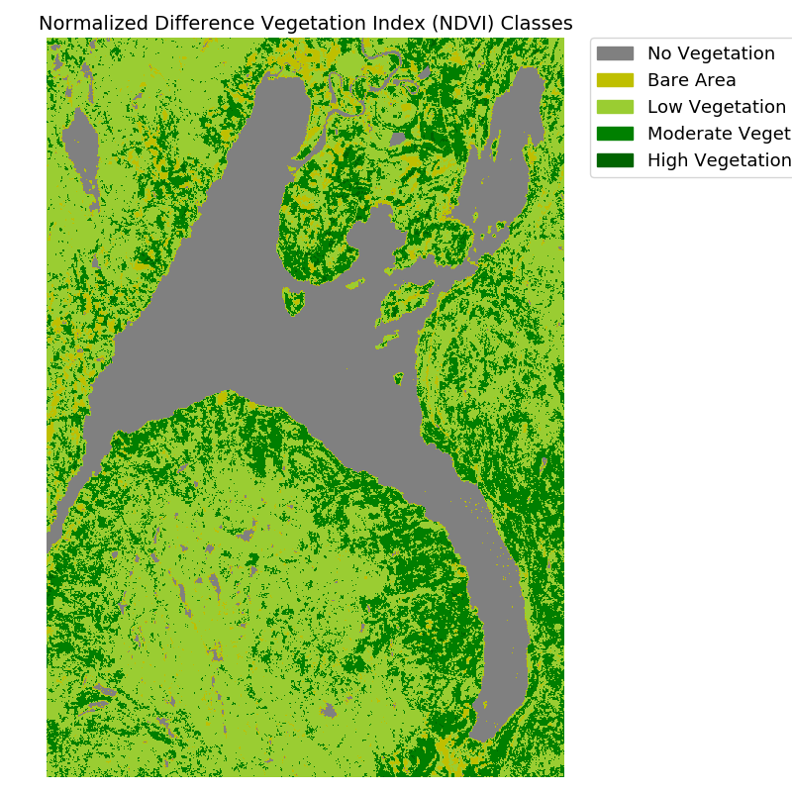
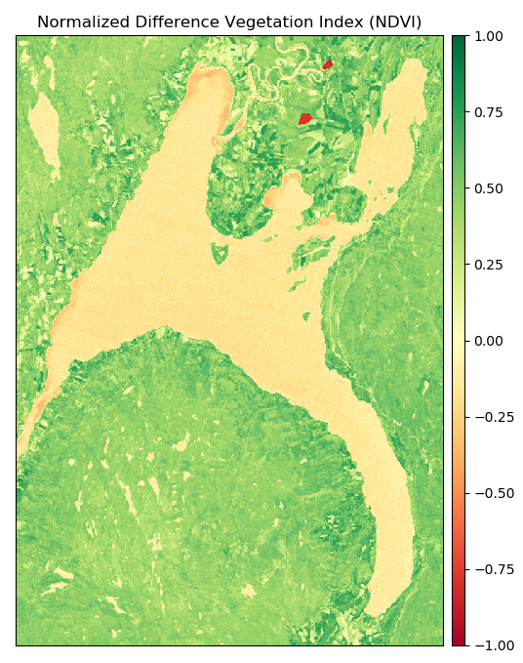
Normalized difference vegetation index

Slide 8
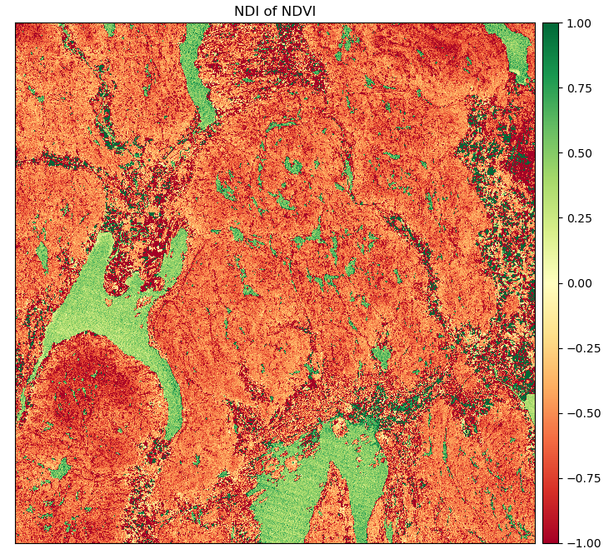
Change detection
NDI of NDVI
Mer vegetasjon i 1993

Slide 9
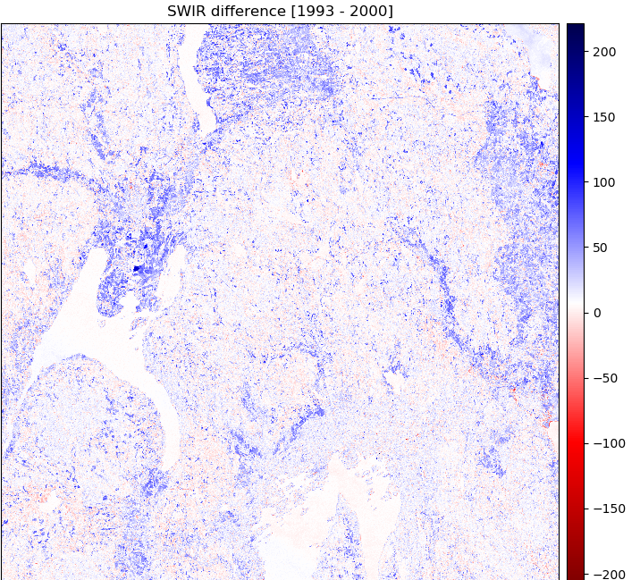
Change detection
Difference
DIFFERENCE = (2000-1993)
Mer refleksjon (blå) i 2000 på flater

Slide 10
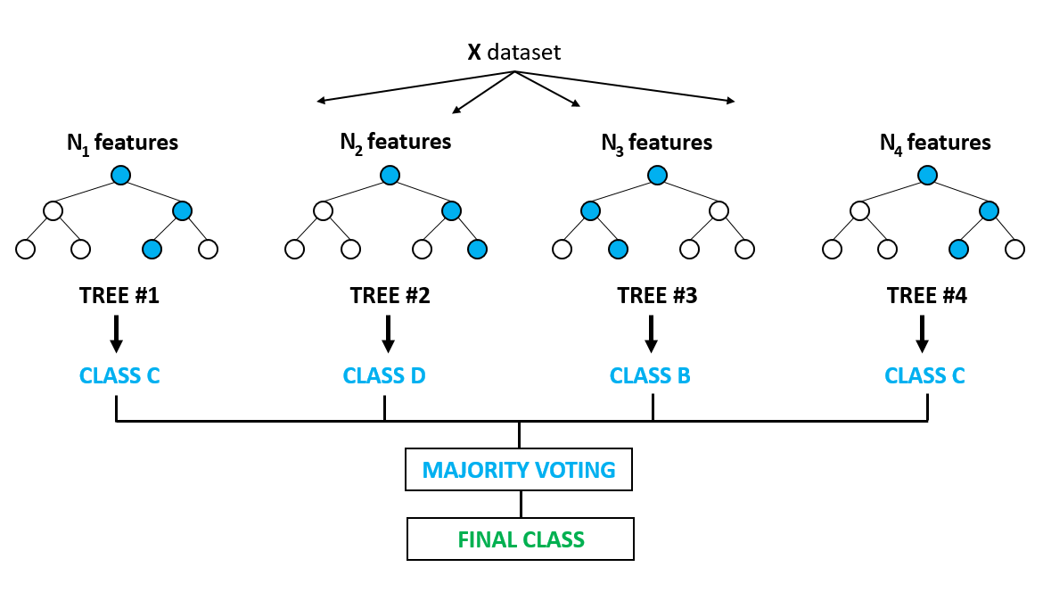
Supervised classification
Machine Learning: Random Forest
Training dataset

Slide 11
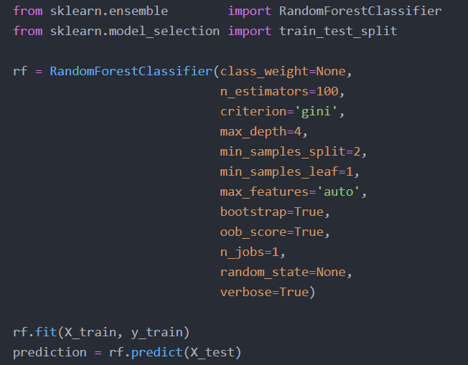
Supervised classification

